Slide 1
Use of Video-Referenced Caregiver Interview (BeDevel-V) to Screen for Autism Spectrum Disorder
Jinju Jung, MA¹; Da-Yea Song, MHS^{1,2}; Guiyoung Bong, MA¹; Jae Hyun Han, MD¹; Hee Jeong Yoo, MD, PhD^{1,2}
1 Department of Psychiatry, Seoul National University Bundang Hospital, Seongnam, South Korea
2 Seoul National University College of Medicine, Seoul, South Korea

Slide 2
>> Table of Contents
1 Background & Objectives
Methods
Results
Conclusion

Slide 3

1
Background & Objectives
Importance of caregiver interview is being emphasized.
Caregiver interview may be easily biased due to interviewee factors (Eaves, Wingert, Ho, & Mickelson, 2006; Miller, Perkins, Dai, & Fein, 2017; Robledo, & Jankovic, 2017).
Using video-referenced interview is suggested (Marrus et al., 2015; Young et al., 2020).
Short videos of key risk factors were made and the effectiveness for screening ASD was explored.
OBJECTIVES

Slide 4


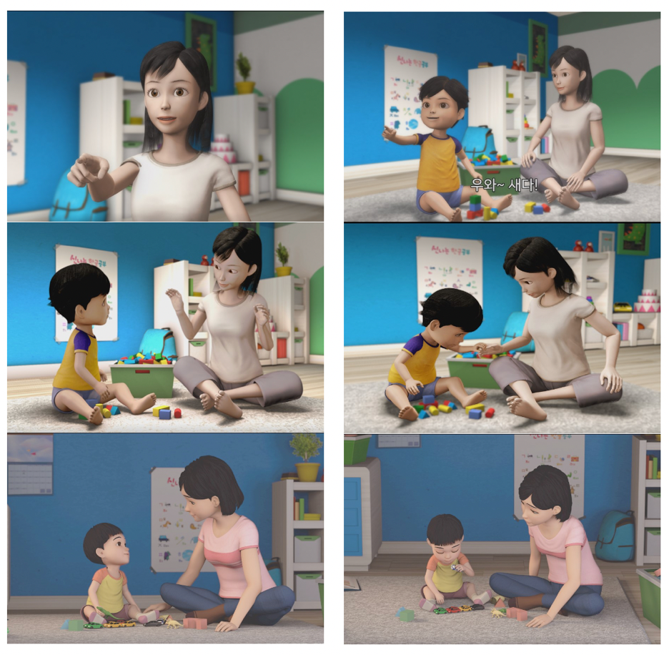
Methods
2
1) Procedure
“Which video does your child resembled the most?”

Slide 5
Key behaviors based on BeDevel (Bong et al., 2021)
1
1
1
2
2
2
Response to joint attention
Echolalia
Pointing behavior
Use of gestures
Interactive social play
Eye contact
Social smile
Restricted, repetitive behaviors
Social referencing
Use of others’ hands

Slide 6
Methods
2
2) Analysis
Analysis of demographics
ROC Curve analysis – predictive value in screening for ASD
Kappa values – comparison between video and standardized interview

Slide 7
3
Results
1) Demographics
N = 30
M(SD) = 32.37(7.06)
N = 91
M(SD) = 36.24(5.86)
 | range | t | p
age | 12-42(m) | 2.98 | .003

Slide 8
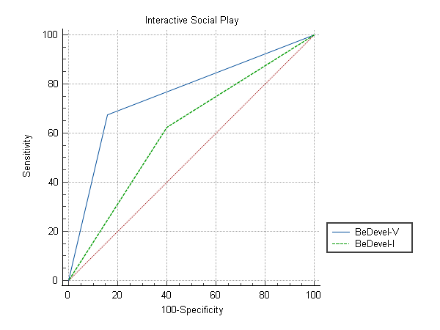
3
Results
2) Predictability
AUC of each item ranged from 0.546 to 0.773.
Items with good predictability
item | AUC
Social referencing | 0.708***
Interactive social play | 0.773***
Eye contact | 0.735***
*** p < .001
Interactive social play measured with BeDevel-V was more effective in screening for ASD (p = .054).

Slide 9
3
Results
3) Comparison with Standardized interview

Slide 10



4
Conclusion
Visual aids can be helpful when interviewing caregivers.
Some behaviors are better understood with visual aids.
Interactive social play is a more complicated and sequential social behavior.
Screening for ASD

Slide 11
5
References
Bong, G., Kim, S. Y., Song, D. Y., Kim, J. H., Hong, Y., Yoon, N. H., ... & Yoo, H. J. (2021). Short caregiver interview and play observation for early screening of autism spectrum disorder: Behavior development screening for toddlers (BeDevel). Autism Research, 14(7), 1472-1483.
Eaves, L. C., Wingert, H. D., Ho, H. H., & Mickelson, E. C. (2006). Screening for autism spectrum disorders with the social communication questionnaire. Journal of Developmental & Behavioral Pediatrics, 27(2), 95-103.
Marrus, N., Glowinski, A.L., Jacob, T., Klin, A., Jones, W., Drain, C.E., … & Constantino, J.N. (2015). Rapid video-referenced ratings of reciprocal social behavior in toddlers: A twin study. Journal of Child Psychology and Psychiatry, 56, 1338– 1346.
Miller, L. E., Perkins, K. A., Dai, Y. G., & Fein, D. A. (2017). Comparison of parent report and direct assessment of child skills in toddlers. Research in autism spectrum disorders, 41-42, 57-65.
Robledo, I., & Jankovic, J. (2017). Media hype: patient and scientific perspectives on misleading medical news. Movement Disorders, 32(9), 1319-1323.
Young, G. S., Constantino, J. N., Dvorak, S., Belding, A., Gangi, D., Hill, A., ... & Ozonoff, S. (2020). A video‐based measure to identify autism risk in infancy. Journal of Child Psychology and Psychiatry, 61(1), 88-94.

Slide 12
Thank you!

